Slide 1

RSM & PAXOS
Computer System Engineering, Fall 2019. (IPADS, SJTU)
Consistency across multiple machines
Yubin Xia

Slide 2
Replication Consistency
Optimistic Replication
Tolerate inconsistency, and fix things up later
Works well when out-of-sync replicas are acceptable
Pessimistic Replication
Ensure strong consistency between replicas
Needed when out-of-sync replicas can cause serious problems

Slide 3
Optimistic Replication

Slide 4
Consistency of Distributed Files
Resolving Inconsistencies
Suppose we have two computers: laptop and desktop
File could have been modified on either system
How to figure out which one was updated?
One approach: use timestamps to figure out which was updated recently
Many file synchronization tools use this approach

Slide 5
Use of Time in Computer Systems
Time is used by many distributed systems
E.g., cache expiration (DNS, HTTP), file synchronizers, Kerberos, ..
Time intervals: how long did some operation take?
Calendar time: what time/date did some event happen at?
Ordering of events: in what order did some events happen?

Slide 6
File Reconciliation with Timestamps
Key Problem
Determine which machine has the newer version of file
Strawman
Use the file with the highest mtime timestamp
Works when only one side updates the file per reconciliation
Notes:
H1: a=1 ->H2
H2: R(a) a=3 ->H1
---
H1: a=1 ->H2
H2: R(a) a=2 ->H1

Slide 7
File Reconciliation with Timestamps
Better plan
Track last reconcile time on each machine
Send file if changed since then, and update last reconcile time
When receiving, check if local file also changed since last reconcile
New Outcome
Timestamps on two versions of a file could be concurrent
Key issue with optimistic concurrency control: optimism was unwarranted
Generally, try various heuristics to merge changes (text diff/merge, etc.)
Worst case, ask the user (e.g., if edited same line of code in C file)
Notes:
H1: a=1 ->H2
H2: R(a) a=2 ->H1
H3: R(a) a=3 ->H1

Slide 8
File Reconciliation with Timestamps
Goal: No Lost Updates
V2 should overwrite V1 if V2 contains all updates that V1 contained
Simple timestamps can't help us determine this

Slide 9
Time Measuring
Measuring time intervals
Computer has a reasonably-fixed-frequency oscillator (e.g., quartz crystal)
Represent time interval as a count of oscillator's cycles
time period = count / frequency
e.g., with a 1MHz oscillator, 1000 cycles means 1msec

Slide 10
Time Measuring
Keeping track of calendar time
Typically, calendar time is represented using a counter from some fixed epoch
For example, Unix time is #seconds since midnight UTC at start of Jan 1, 1970
Can convert this counter value into human-readable date/time, and vice-versa
Conversion requires two more inputs: time zone, data on leap seconds
Notes:
[ demo: date +%s shows number of seconds after the Unix epoch ]

Slide 11
Time Measuring
What happens when turn off the computer?
"Real-Time Clock" (RTC) chip remains powered, with battery / capacitor
Stores current calendar time, has an oscillator that increments periodically
Maintaining accurate time
Accuracy: for calendar time, need to set the clock correctly at some point
Precision: need to know oscillator frequency (drift due to age, temp, etc.)

Slide 12
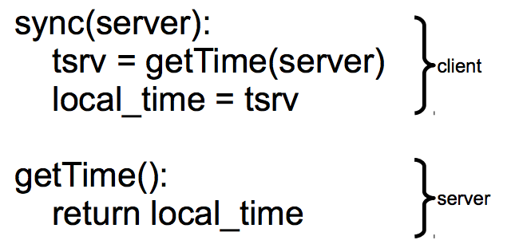
Clock Synchronizing
Synchronizing a clock over the internet: NTP
Query server's time, adjust local time accordingly
Notes:
ntpdate -d 203.17.251.1
% ntpdc -n 203.17.251.1
ntpdc> peers
ntpdate -d ntp.sjtu.edu.cn

Slide 13
Clock Synchronizing
Need to take into account network latency
Simple estimate: RTT/2
When does this fail to work well?
Asymmetric routes, with different latency in each direction
Queuing delay, unlikely to be symmetric even for symmetric routes
Busy server might take a long time to process client's request
Can use repeated queries to average out (or estimate variance) for second two

Slide 14
Estimating Network Latency
sync(server):
t_begin = local_time
tsrv = getTime(server)
t_end = local_time
delay = (t_end-t_begin) / 2
offset = (t_end-delay) - tsrv
local_time = local_time - offset
Notes:
ntpdate -d 203.17.251.1
% ntpdc -n 203.17.251.1
ntpdc> peers

Slide 15
Clock Synchronizing
What if a computer's clock is too fast
E.g., 5 seconds ahead
Naive plan: reset it to the correct time
Can break time intervals being measured (e.g., negative interval)
Can break ordering (e.g., older files were created in the future)
"make" is particularly prone to these errors
Principle: time never goes backwards
Idea: temporarily slow down or speed up the clock
Typically cannot adjust oscillator (fixed hardware)
Adjust oscillator frequency estimate, so counter advances faster / slower

Slide 16
Slew Time
sync(server):
t_begin = local_time
tsrv = getTime(server)
t_end = local_time
delay = (t_end-t_begin) / 2
offset = (t_end-delay) - tsrv
freq = base + ε * sign(offset)
sleep(freq * abs(offset) / ε)
freq = base
timer_intr(): # on every oscillator tick
local_time = local_time + 1/freq
temporarily speed up / slow down local clock

Slide 17
Improving Time Precision
If only adjust our time once
An inaccurate clock will lose accuracy
Need to also improve precision, so we don't need to slew as often
Assumption: poor precision caused by poor estimate of oscillator frequency
Can measure difference between local and remote clock "speeds" over time
Adjust local frequency estimate based on that information
In practice, may want more stable feedback loop (PLL): look at control theory

Slide 18
Vector Timestamps
Idea: vector timestamps
Store a vector of timestamps from each machine
Entry in vector keeps track of the last mtime
V1 is newer than V2 if all of V1's timestamps are >= V2's
V1 is older than V2 if all of V1's timestamps are <= V2's
Otherwise, V1 and V2 were modified concurrently, so conflict
If two vectors are concurrent, one computer modified file without seeing the latest version from another computer
If vectors are ordered, everything is OK as before

Slide 19
Vector Timestamps
Cool property of version vectors:
A node's timestamps are only compared to other timestamps from same node
Time synchronization not necessary for reconciliation w/ vector timestamps
Can use a monotonic counter on each machine
Does calendar time still matter?
More compact than vector timestamps
Can help synchronize two systems that don't share vector timestamps

Slide 20
Pessimistic replication
RSM & Paxos

Slide 21
Pessimistic Replication
Some applications may prefer not to tolerate inconsistency
E.g., a replicated lock server, or replicated coordinator for 2PC
E.g., Better not give out the same lock twice
E.g., Better have a consistent decision about whether transaction commits
Trade-off: stronger consistency with pessimistic replication means:
Lower availability than what you might get with optimistic replication

Slide 22
Single-copy Consistency
Problem of optimistic way: replicas get out of sync
One replica writes data, another doesn't see the changes
This behavior was impossible with a single server
Ideal goal: single-copy consistency
Property of the externally-visible behavior of a replicated system
Operations appear to execute as if there's only a single copy of the data
Internally, there may be failures or disagreement, which we have to mask
Similar to how we defined serializability goal ("as if executed serially")

Slide 23
Replicating a Server
Strawman
Clients send requests to both servers
Tolerating faults: if one server is down, clients send to the other
Tricky case: what if there's a network partition?
Each client thinks the other server is dead, keeps using its server
Bad situation: not single-copy consistency!

Slide 24
Handling Network Partitions
Issue: Clients may disagree about what servers are up
Hard to solve with 2 servers, but possible with 3 servers
Idea: require a majority servers to perform operation
In case of 3 servers, 2 form a majority
If client can contact 2 servers, it can perform operation (otherwise, wait)
Thus, can handle any 1 server failure

Slide 25
Quorum
Define separate read &write quorums: Q_{r} & Q_{w}
Q_{r} + Q_{w} > N_{replicas} (Why?)
Confirm a write after writing to at least Q_{w} of replicas
Read at least Q_{r} agree on the data or witness value
Example
In favor of reading: N_{replicas} = 5, Q_{w} = 4, Q_{r} = 2
In favor or updating: N_{replicas} = 5, Q_{w} = 2, Q_{r} = 4
Enhance availability by Q_{w} = N_{replicas} & Q_{r} = 1

Slide 26
Quorum
Provide no before-or-after or all-or-nothing
If reading & writing requests come from a site
Easy…
If reading from multiple sites, writing from one site
Maintain a version number at that site
If writing from multiple sites
Protocol providing a distributed sequencer
Another complicating consideration
Performance maximization

Slide 27
Simple Implementation: Replicated Logs
Replicated Logs
Log client operations, including both R/W, and numbered
Key issue: agreeing on the order of operations
Coordinator handles one client operation at a time
Coordinator chooses an order for all operations (assigns log sequence number)
Coordinator issues the operation to each replica
When is it OK to reply to client?
Must wait for majority of replicas to reply
Otherwise, if a minority crashes, remaining servers may continue without op

Slide 28
Handling Network Partitions
Why does the majority rule work?
Any two majority sets of servers overlap
Suppose two clients issue operations to a majority of servers
Must have overlapped in at least one server, will help ensure single-copy

Slide 29
Handling Network Partitions
Problem: replicas can become inconsistent
Issue: clients' requests to different servers can arrive in different order
How do we ensure the servers remain consistent?

Slide 30
RSM

Slide 31
RSM: Replicated State Machines
A general approach to making consistent replicas of a server:
Start with the same initial state on each server
Provide each replica with the same input operations, in same order
Ensure all operations are deterministic
E.g., no randomness, no reading of current time, etc.
These rules ensure each server will end up in the same final state

Slide 32
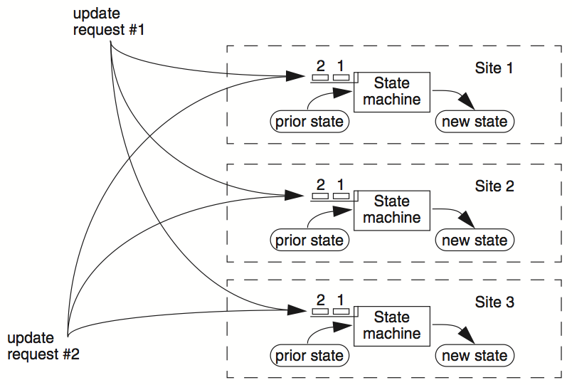

Slide 33
C₁
S₁
write₁(x)
C₂
S₂
write₂(x)
(replica of S₁)

Slide 34
C₁
S₁
write₁(x)
write₂(x)
C₂
S₂
write₁(x)
write₂(x)
(replica of S₁)
problem: How to ensure the order of operations?

Slide 35
RSM: Replicated State Machines
RSMs provide single-copy consistency
Operations complete as if there is a single copy of the data
Though internally there are replicas
RSMs use a primary-backup mechanism for replication
Using view server ensures that only one replica acts as the primary
It can also recruit new backups after servers fail

Slide 36
Primary/Backup Model
Primary does important stuff
Ensures that it sends all updates to the backup before ACKing the coordinator
Chooses an ordering for all operations, so that the primary and backup agree
Decides all non-deterministic values (e.g., random(), time())

Slide 37
What if Primary Fails?
Idea 1: Coordinator knows about both primary and backup, and decides which to use
Won't work: split brain syndrome
Multiple coordinators come to independent, and different, conclusions about who is primary when there are network partitions
Idea 2: Have human decide when to switch from primary to backup
Not unreasonable for small web services

Slide 38
Primary/Backup Model
(primary)
S₁
C
S₂
if primary fails, C knows about S₂, and switches
(backup)
attempt: coordinators communicate with primary servers, who communicate with backup servers

Slide 39
Primary/Backup Model
(primary)
X
S₁
C
S₂
if primary fails, C knows about S₂, and switches
(backup)
attempt: coordinators communicate with primary servers, who communicate with backup servers

Slide 40
Primary/Backup Model
X
S₁
C
S₂
if primary fails, C knows about S₂, and switches
(primary)
attempt: coordinators communicate with primary servers, who communicate with backup servers

Slide 41
Multiple Coordinators + the Network = Problems
(primary)
C₁
S₁
network partition
C₂
S₂
(backup)
attempt: coordinators communicate with primary servers, who communicate with backup servers

Slide 42
Multiple Coordinators + the Network = Problems
(primary)
C₁
S₁
network partition
C₂
S₂
(backup, but primary for C₂)
C₁ and C₂ are using different primaries;
S₁ and S₂ are no longer consistent

Slide 43
View Server
1. The view server keeps a table that maintains a sequence of "view"
Each view contains the view number, the primary server, and the backup server
2. The view server alerts each server as to whether it's the primary or the backup
3. Upon receiving any updates, the primary will receive an ACK from the backup before responding to the view server (just as before)
4. Coordinators make requests to the view server asking who is primary
Coordinators then contact the primary

Slide 44

View Server
(primary)
S₁
S₁
primary
C
primary?
VS
S₁
backup
1: S₁, S₂
S₂
(backup)
Use a view server, which determines which replica is the primary

Slide 45
View Server
To discover failures
Replicas ping to the view server
If view server misses N pings in a row, it deems a server to be dead
Basic failure (actual worker crash):
1. Primary fails; pings cease
2. View server lets S2 know it's primary, and it handles any client requests
Before S2 knowing it's the primary, it will simply reject requests that come directly from coordinators
3. View server will eventually recruit a new idle server to act as backup

Slide 46
Failure of Primary
(dead)
X
S₁
C
VS
lack of pings indicates to VS that S₁ is down
1: S₁, S₂
S₂
(backup)
Use a view server, which determines which replica is the primary

Slide 47
Failure of Primary
(dead)
X
S₁
C
primary?
VS
S₂
primary
1: S₁, S₂
2: S₂, --
S₂
S₂
(primary)
before S₂ knows it's primary, it will reject any requests from clients

Slide 48
Facing Network Partitions
A few rules
1. Primary must wait for backup to accept each request
2. Non-primary must reject direct coordinator requests
That's what happened in the earlier failure, in the interim between the failure and S2 hearing that it was primary
3. Primary must reject forwarded requests
I.e., it won't accept an update from the backup
4. Primary in view i must have been primary or backup in view i-1

Slide 49
Network Partitions
Network Partition between VS and S₁
(primary)
lack of pings indicates to VS that S₁ is down
S₁
S₁
C
VS
1: S₁, S₂
S₂
(backup)

Slide 50
Network Partitions
Network Partition between VS and S₁
(primary)
S₁
S₁
VS makes S₂ primary
C
VS
primary
1: S₁, S₂
2: S₂, --
S₂
rejected by S₂
(backup)
it's okay! S2 will act as backup
(accept updates from S1, reject coordinator requests)
problem: what happens before S₂ knows it's the primary?

Slide 51
Network Partitions
Network Partition between VS and S₁
rejected by S₁
(Cannot get ACK from S₂)
(primary)
S₁
S₁
C
VS
1: S₁, S₂
2: S₂, --
S₂
(primary)
also okay! S1 won't be able to act as primary
(can't accept client requests because it won't get ACKs from S2)
problem: what happens after S2 knows it's the primary,
but S1 also thinks it is?

Slide 52
Consider S₁ being Partitioned from the VS
Before S2 hears about View #2:
S1 can process operations from coordinators, S2 will accept forwarded requests
S2 will reject operations from coordinators who have heard about view #2
After S2 hears about View #2:
If S1 receives coordinator requests, it will forward. S2 will reject (not ACK), so S1 can no longer act as primary.
S1 will send error to coordinator, coordinator will ask VS for new view, learn about view #2, and coordinator will re-send to S2
The commit point of switch-over: when S2 hears about View #2

Slide 53
(primary)
S₁
S₁
C
X
VS
1: S₁, S₂
S₂
(backup)
problem: what if view server fails?

Slide 54
Paxos
Distributed consensus mechanism

Slide 55
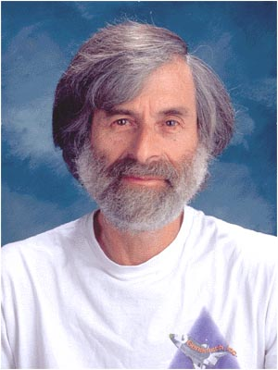
Leslie Lamport
http://ipads.se.sjtu.edu.cn/courses/cse-g/2012f/Schedule_files/paxos-simple.pdf

Slide 56
Paxos
Paxos' properties: correct + fault-tolerance
No guaranteed termination
Goal: have all acceptors agree to a value V associated with a proposal
Proposer
Proposer
Proposer
Acceptor
Client
Network
Acceptor
Acceptor
leader
Learner
Learner
quorum
Learner
Paxos: one machine may serve several roles

Slide 57
Paxos Players
Client
makes a request
Proposer
Get a request and run the protocol
Leader = elected Coordinator
Acceptor
Remember the state of the protocol
Quorum = any majority of Acceptors
Learner
When agreement has been reached, a Learner executes the request and/or sends a response back to the Client

Slide 58
General Approach
One proposer decides to be the leader
Leader proposes a value and solicits acceptance from acceptors (majority)
Leader announces result or try again
What if >1 proposers become leaders simultaneously?
What if there is a network partition?
What if a leader crashes in the middle of solicitation?
What if a leader crashes after deciding but before announcing results?
. . .

Slide 59
Political Science 101
Paxos has rounds; each round has a unique ID (N)
Rounds are asynchronous
Time synchronization not required
If you are in round j and hear a message from round j+1, abort everything and move over to round j+1
Use timeouts; may be pessimistic
Each round itself broken into phases
Phases are also asynchronous

Slide 60
Paxos in Action: Phase 0
Client sends a request to a proposer
Proposer
request
Acceptor
Client
Network
Acceptor
Acceptor
quorum
Learner

Slide 61
Paxos in Action: Phase 1a (Prepare)
Leader creates a proposal N and send to quorum
N is greater than any previous proposal number seen by this proposer
Leader
proposal N
Acceptor
Client
Network
Acceptor
Acceptor
quorum
Learner

Slide 62
Paxos in Action: Phase 1b (Prepare)
Acceptor: if proposal ID > any previous proposal
reply with the highest past proposal number and value
promise to ignore all IDs < N
else ignore (proposal is rejected)
Leader
promise N
Acceptor
Client
Network
Acceptor
Acceptor
quorum
Learner

Slide 63
Paxos in Action: Phase 2a (Accept)
Leader: if receive enough promise
set a value V to the proposal. V can be decided value or new value
send accept request to quorum with the chosen value V
Leader
accept request(N, V)
Acceptor
Client
Network
Acceptor
Acceptor
quorum
Learner
Ignore all proposals < N

Slide 64
Paxos in Action: Phase 2b (Accept)
Acceptor: if the promise still holds
register the value V
send accepted message to Proposer/Learners
else ignore the message
Leader
accepted
Acceptor
Client
Network
Acceptor
Acceptor
accepted
quorum
Learner
Learner
Ignore all proposals < N

Slide 65
Paxos in Action: Phase 3 (Learn)
Learner: responds to Client and/or take action on the request
Leader
Acceptor
Client
Network
Acceptor
Acceptor
quorum
Learner
Learner
Ignore all proposals < N

Slide 66
Paxos Setup
Client
Client
Paxos Node
Paxos Node
Paxos Node
Proposer
Proposer
Proposer
Acceptor
Acceptor
Acceptor
. . .
Learner
Learner
Learner
N_{a}: highest proposal number accepted
V_{a}: accepted value of N_{a}
N_{h}: highest proposal number seen
M_{n}: my proposal number
each round of Paxos, each Node

Slide 67
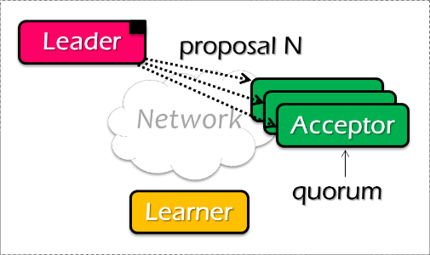
Paxos Pseudo-code
N_{a}: highest proposal number accepted
V_{a}: accepted value of N_{a}
N_{h}: highest proposal number seen
M_{n}: my proposal number
A node decides to be Leader
Leader chooses M_{n} > N_{h}
Leader sends <proposal, M_{n} > to all nodes
Acceptor receives <proposal, N>
if N < N_{h}
reply <promise-reject>
else
N_{h} = N
reply <promise-ok, N_{a}, V_{a}>
Ignore all proposals < N_{h}

Slide 68

Paxos Pseudo-code
N_{a}: highest proposal number accepted
V_{a}: accepted value of N_{a}
N_{h}: highest proposal number seen
M_{n}: my proposal number
If Leader gets promise-ok from a majority
If Leader fails to get majority promise-ok
Upon receiving <accept, N, V>
if V != null, V = the value of the highest N_{a} received
if V = null, then Leader can pick any V
send <accept, M_{n}, V> to all nodes
delay and restart Paxos
if N < N_{h}
reply <accept-reject>
else
N_{a} = N; V_{a} = V; N_{h} = N;
reply <accept-ok>

Slide 69
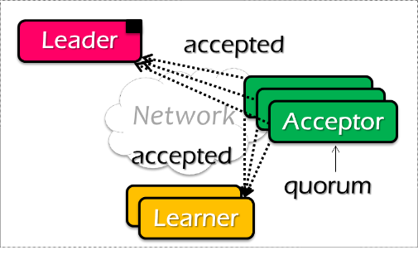
Paxos Pseudo-code
N_{a}: highest proposal number accepted
V_{a}: accepted value of N_{a}
N_{h}: highest proposal number seen
M_{n}: my proposal number
If Leader gets accept-ok from a majority
If Leader fails to get majority accept-ok
send <decide, V_{a}> to all nodes
delay and restart Paxos

Slide 70
派克索斯偽代碼
N_{a}: highest proposal number accepted
V_{a}: accepted value of N_{a}
N_{h}: highest proposal number seen
M_{n}: my proposal number
N_{a} = V_{a} = null
N_{h} = N0:0
N_{a} = V_{a} = null
N_{h} = N1:0
N_{a} = V_{a} = null
N_{h} = N2:0
M_{n} = N1:1
<proposal, N1:1>
<proposal, N1:1>
N_{h} = N1:1
N_{a} = null
V_{h} = null
N_{h} = N1:1
N_{a} = null
V_{h} = null
<promise, null, null>
<promise, null, null>
<accept, N1:1, V1>
<accept, N1:1, V1>
N_{h} = N1:1
N_{a} = N1:1
V_{h} = V1
N_{h} = N1:1
N_{a} = N1:1
V_{h} = V1
<accept-ok>
<accept-ok>
<decide, V1>
<decide, V1>
Time
Notes:
Majority gets V1 then is the checking point there.
It’s not determined at all, but it exists.
51% people accept v1.

Slide 71
派克索斯內部
N_{a}: highest proposal number accepted
V_{a}: accepted value of N_{a}
N_{h}: highest proposal number seen
M_{n}: my proposal number
為什麼要設置多個接受者？ 單一接受方的失敗將停止決策 為什麼不接受第一個建議，拒絕其餘的呢？ 多個領導者導致沒有多數接受 領導者去世 如果多個領導者處於活動狀態，該怎麼辦？ 兩位領導人都能看到大多數承諾嗎？ 然後。。。？

Slide 72
派克索斯內部
N_{a}: highest proposal number accepted
V_{a}: accepted value of N_{a}
N_{h}: highest proposal number seen
M_{n}: my proposal number
何時選擇值 V？ 領導者獲得多數 [承諾]。 大多數接受者接受 [接受， N， V] 領導者獲得多數 [接受]... 如果接受方在發送承諾後失敗怎麼辦？ 必須記住Nh 如果接受方在接受後失敗怎麼辦？ 必須記住Nh和Na Va 如果領導者在發送接受時失敗怎麼辦？ 再次建議 Mn

Slide 73
問題
N_{a}: highest proposal number accepted
V_{a}: accepted value of N_{a}
N_{h}: highest proposal number seen
M_{n}: my proposal number
假設接受方為 A、B 和 C。A 和 B 也是提議者。
Paxos 如何確保以下事件序列不會發生？
實際會發生什麼，最終選擇哪個值？
A sends <prepare, 1> requests with proposal number 1, and gets responses from A, B, and C
A sends <accept,1, "foo"> to A and C and gets responses from both. Because a majority accepted, A thinks that "foo" has been chosen. However, A crashes before sending an <accept, 1, "foo"> to B
B sends <prepare, 2> messages with proposal number 2, and gets responses from B and C
B sends <accept, 2, "bar"> messages to B and C and gets responses from both, so B thinks that "bar" has been chosen
Notes:
Corner Case 太多了
不晓音律不缺题目
呵呵

Slide 74

問題
N_{a}: highest proposal number accepted
V_{a}: accepted value of N_{a}
N_{h}: highest proposal number seen
M_{n}: my proposal number
A
C
M_{n} = 1
<proposal, 1>
<promise, …>
B
<accept, 1, foo>
M_{n} = 2
<proposal, 2>
<promise, …>
<accept, 2, bar>
Time
Notes:
C = B： for B： 接受

Slide 75
問題
N_{a}: highest proposal number accepted
V_{a}: accepted value of N_{a}
N_{h}: highest proposal number seen
M_{n}: my proposal number
A
C
M_{n} = 1
<proposal, 1>
<promise, …>
B
<accept, 1, foo>
M_{n} = 2
<proposal, 2>
<promise, 1, foo>
<accept, 2, foo>
Time

Slide 76
什麼會出錯？
進程失敗 多數不包括 當進程重新開機時，它使用日誌來檢索過去的決定（如果有）和過去看到的選票 ID。試圖瞭解過去的決定 領導者失敗 開始另一輪 已刪除的消息 如果太片狀，只需開始另一輪 協定可能永遠不會結束 - 艱難的運氣！ 未違反不可能的結果 如果將來某個時候進展順利，就達成了共識

Slide 77
派克索斯摘要
Paxos 使我們能夠確保對一組節點中的一組事件進行一致的（總）排序 事件 + 命令 / 操作 / 狀態更新 每台電腦都將具有最新狀態或早期版本的狀態

Slide 78
派克索斯摘要
更改系統 告訴提議者（領導者）事件 （注：這些請求可能同時發生） 領導選擇其下一個最高 ID，並詢問所有具有該 ID 的接受者的建議 當大多數接受者接受建議時，接受的事件將發送給學員 學員執行事件（例如，更新系統狀態）

Slide 79
RSM 的 Paxos
容錯 RSM 需要一致的副本視圖 視圖：[主備份]（例如，[節點1，節點2]） 所有活動節點必須就視圖更改的順序達成一致 [vid-1，主資料庫，備份]，. . . 使用 Paxos 商定 [主備份] 每個 Paxos 實例都同意單個視圖 （例如，[2，節點1，節點2]）

Slide 80
CAP 定理

Slide 81
示例
亞馬遜有兩個區域：美國和歐元 所有美國使用者都連接到美國區域 所有歐元使用者都連接到歐元區 定義可用性和一致性 C：所有使用者都看到專案的實際數量 非 C：使用者看到 1 項左，但實際上為 0 答：所有使用者都可以隨時購買商品（如果有的話） 非 A：使用者可能會"現在無法購買，請稍候再試用"

Slide 82
CAP 定理： 2 之 3
分散式運算機系統不可能同時提供以下所有三項保證 一致性（所有節點同時查看相同的資料） 可用性（保證每個請求都會收到有關其成功還是失敗的回應） 分區容差（系統繼續運行，儘管系統部分出現任意消息丟失或故障）

Slide 83
分區容差
"P"通常是一個現實 您永遠不能依靠網路連接 美聯社：犧牲C 如果您正在銷售書籍，並且無法交付客戶訂購的書籍 也許只是道歉和一張小小的禮券 CP：犧牲A 如果您正在銷售機票，但無法交付 客戶可以起訴您

Slide 84
不是二元決策
示例：在網路磁碟分割期間，CP 系統並不意味著沒有"A" 如果歐元區和美國區斷開連接，美國區仍可保持可用 只有歐元區不可用 當網路再次連接時，將美國區域資料應用於歐元區，以便保持一致性

